Slide 1
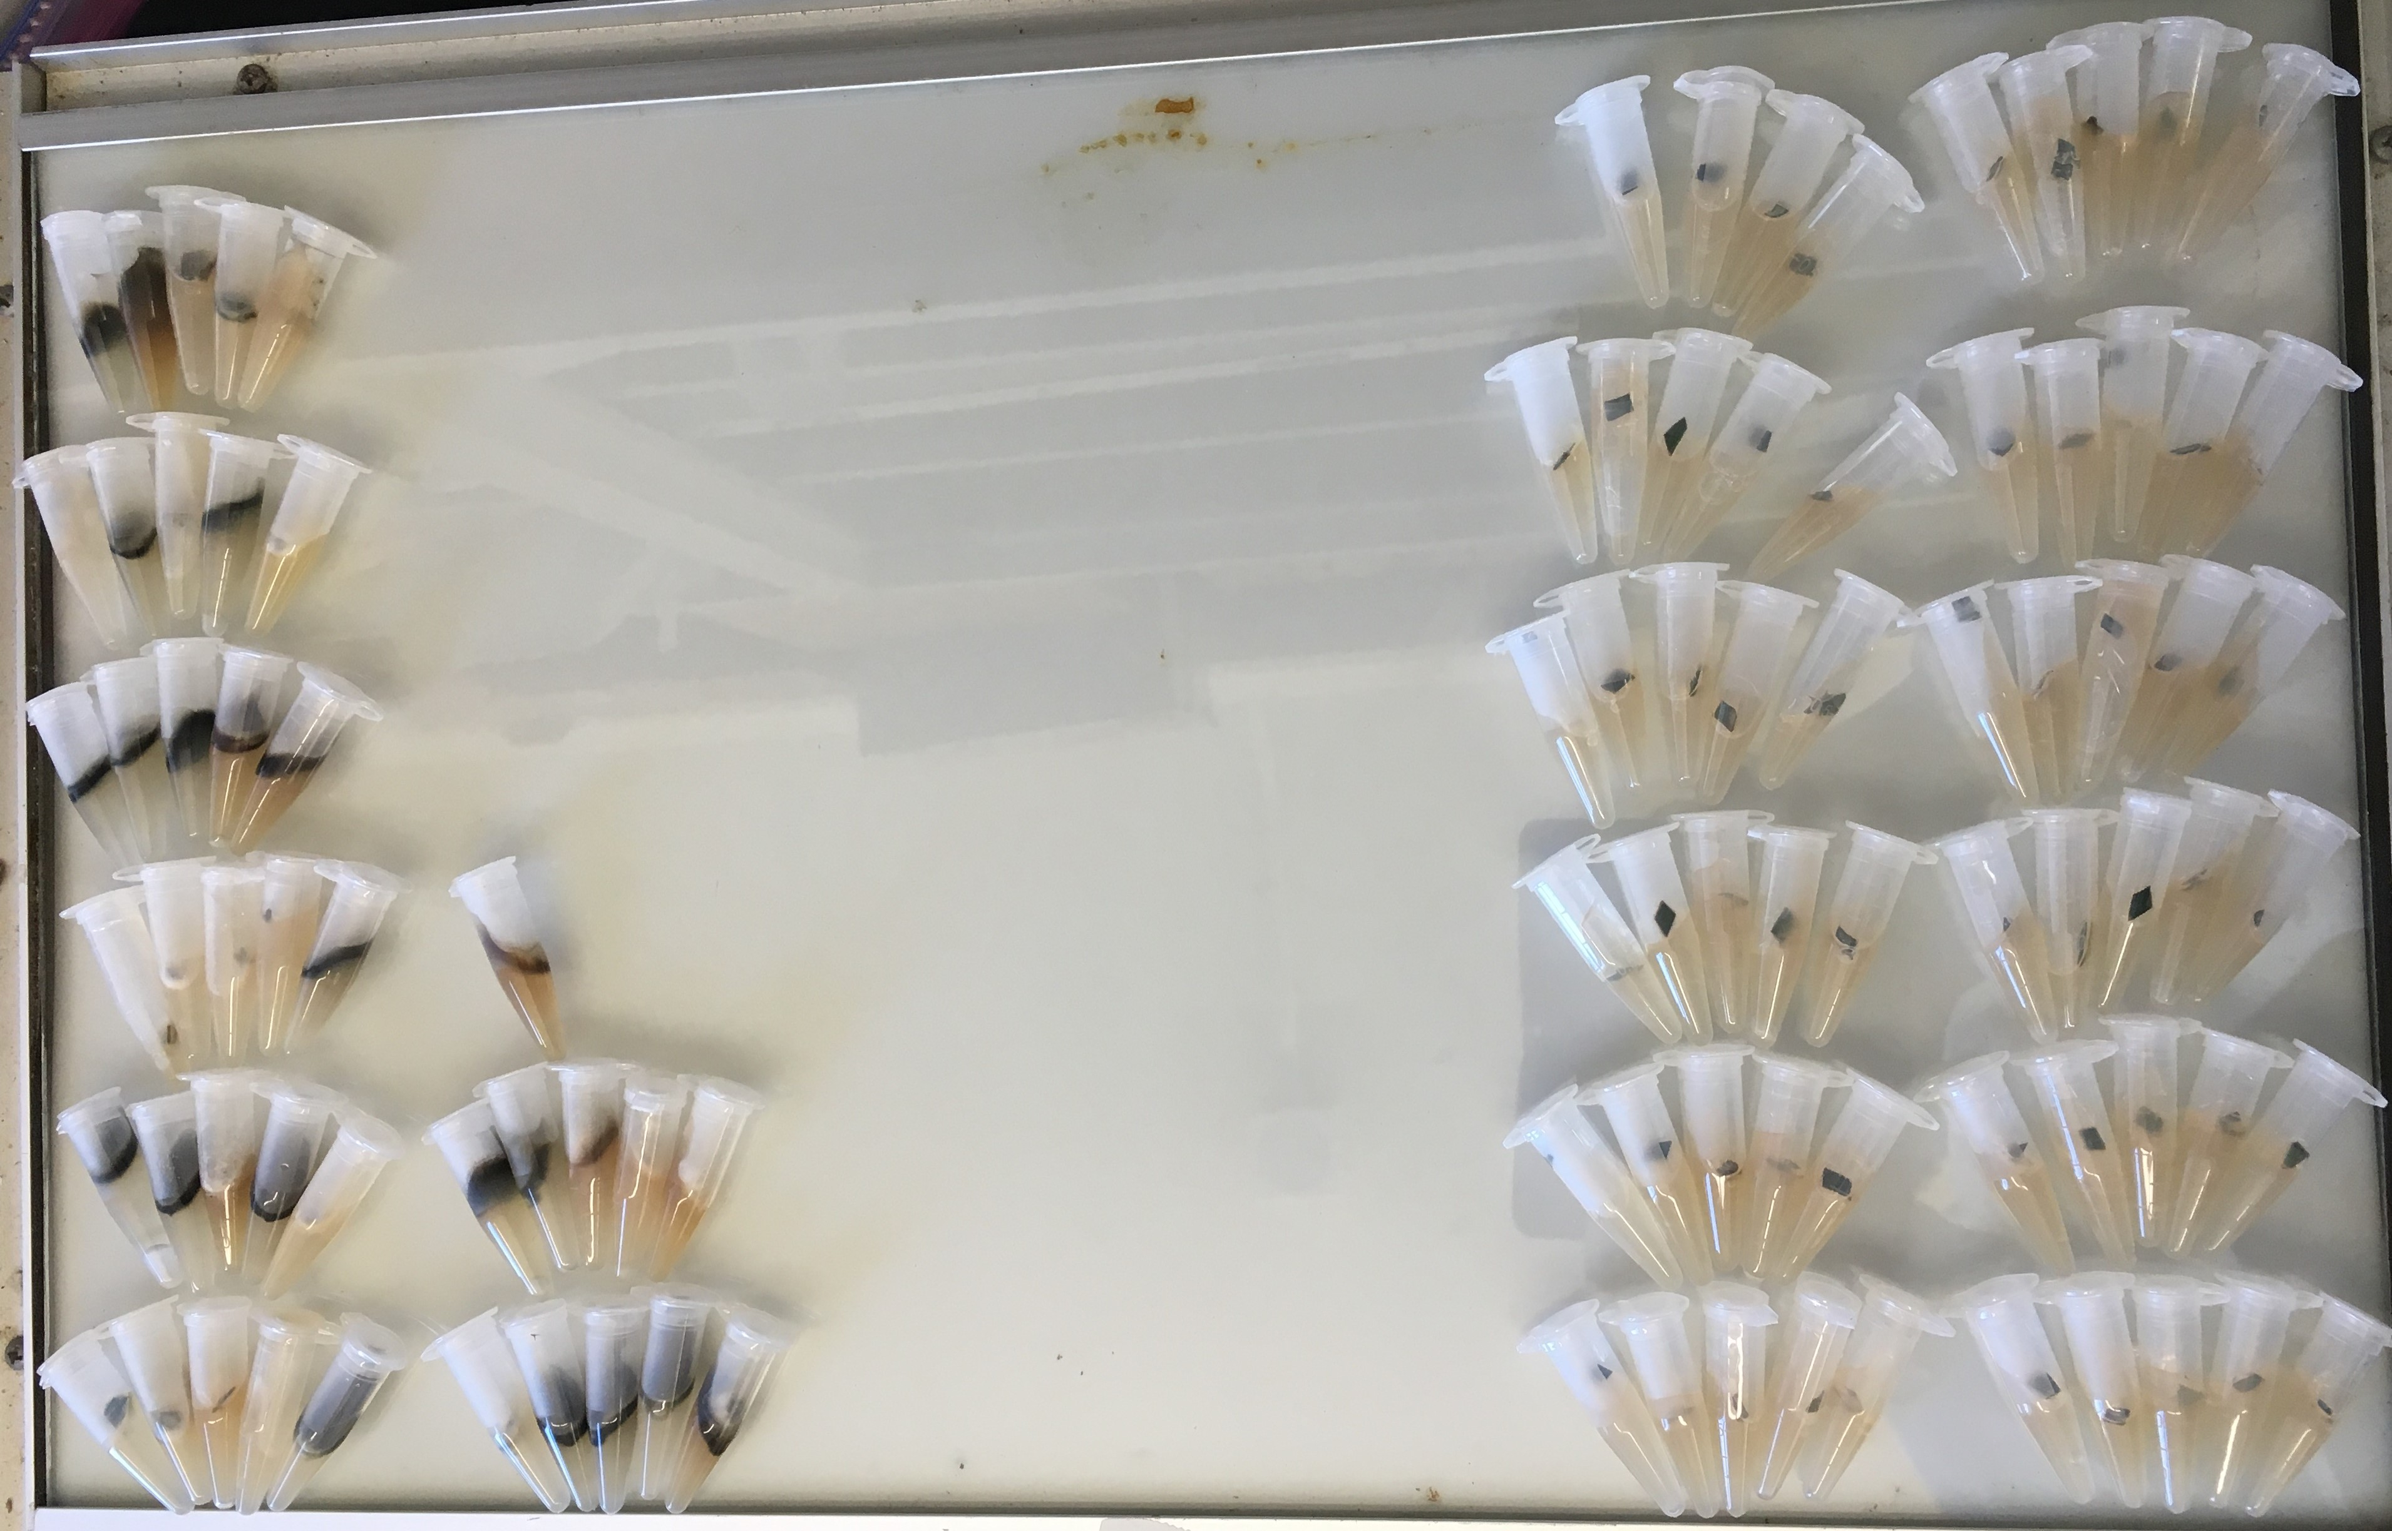
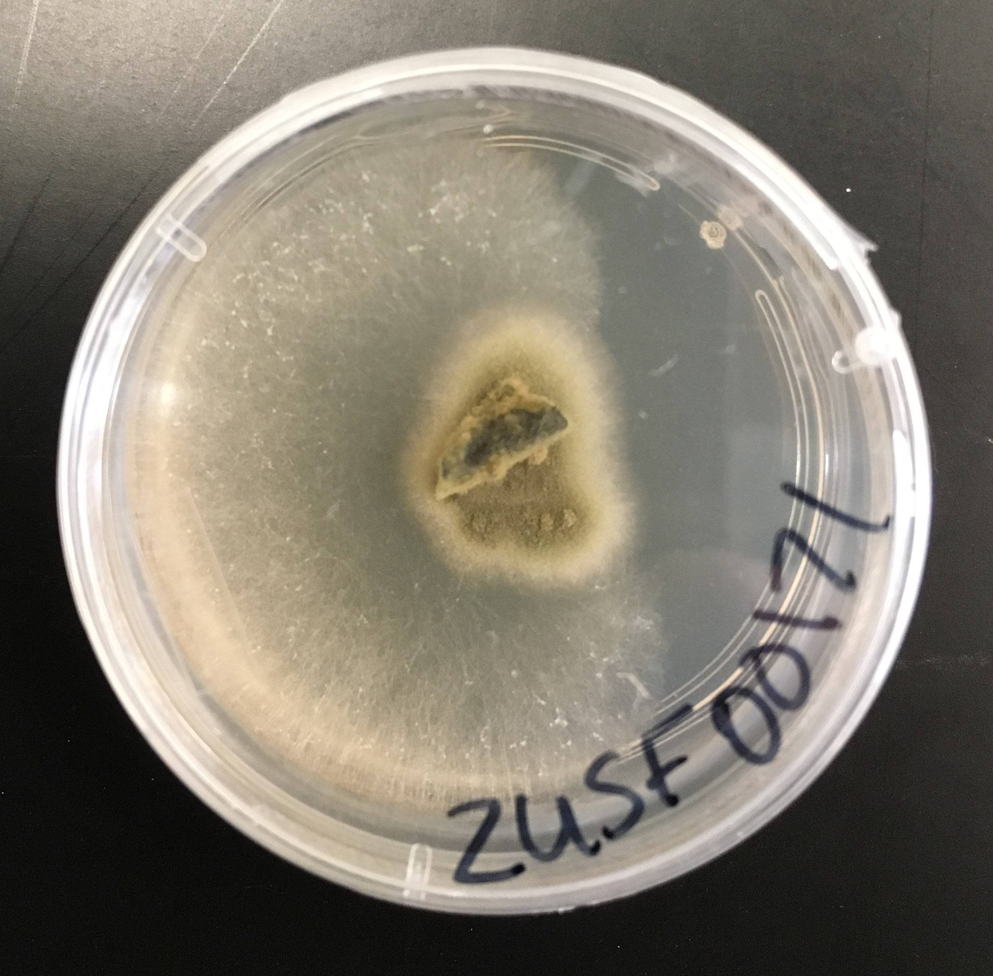
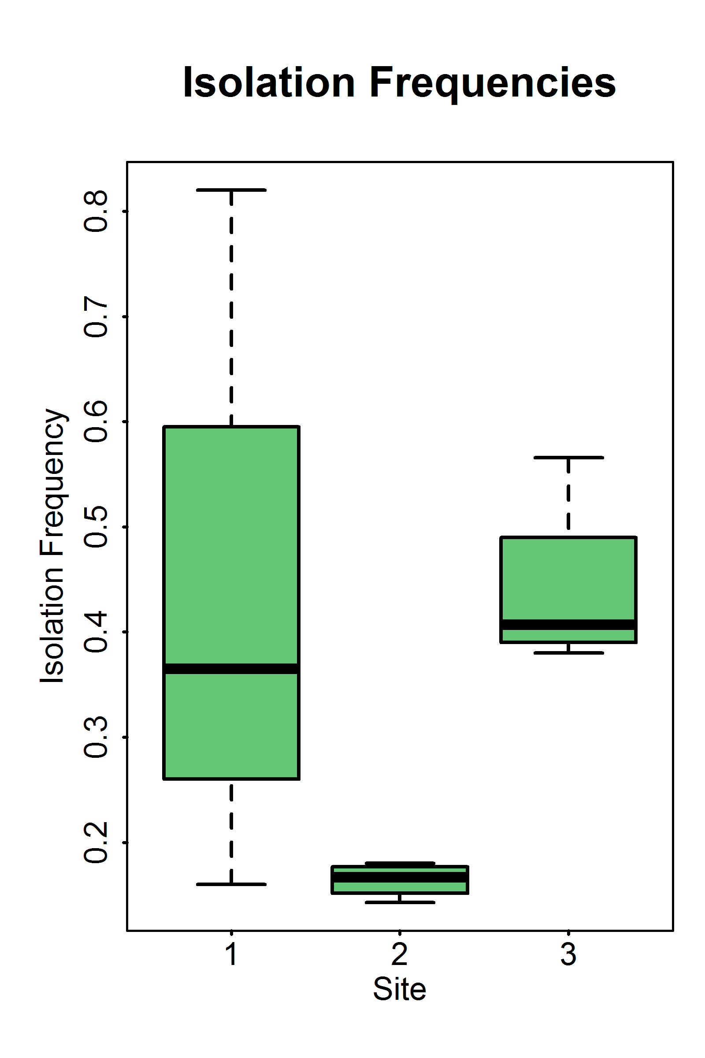
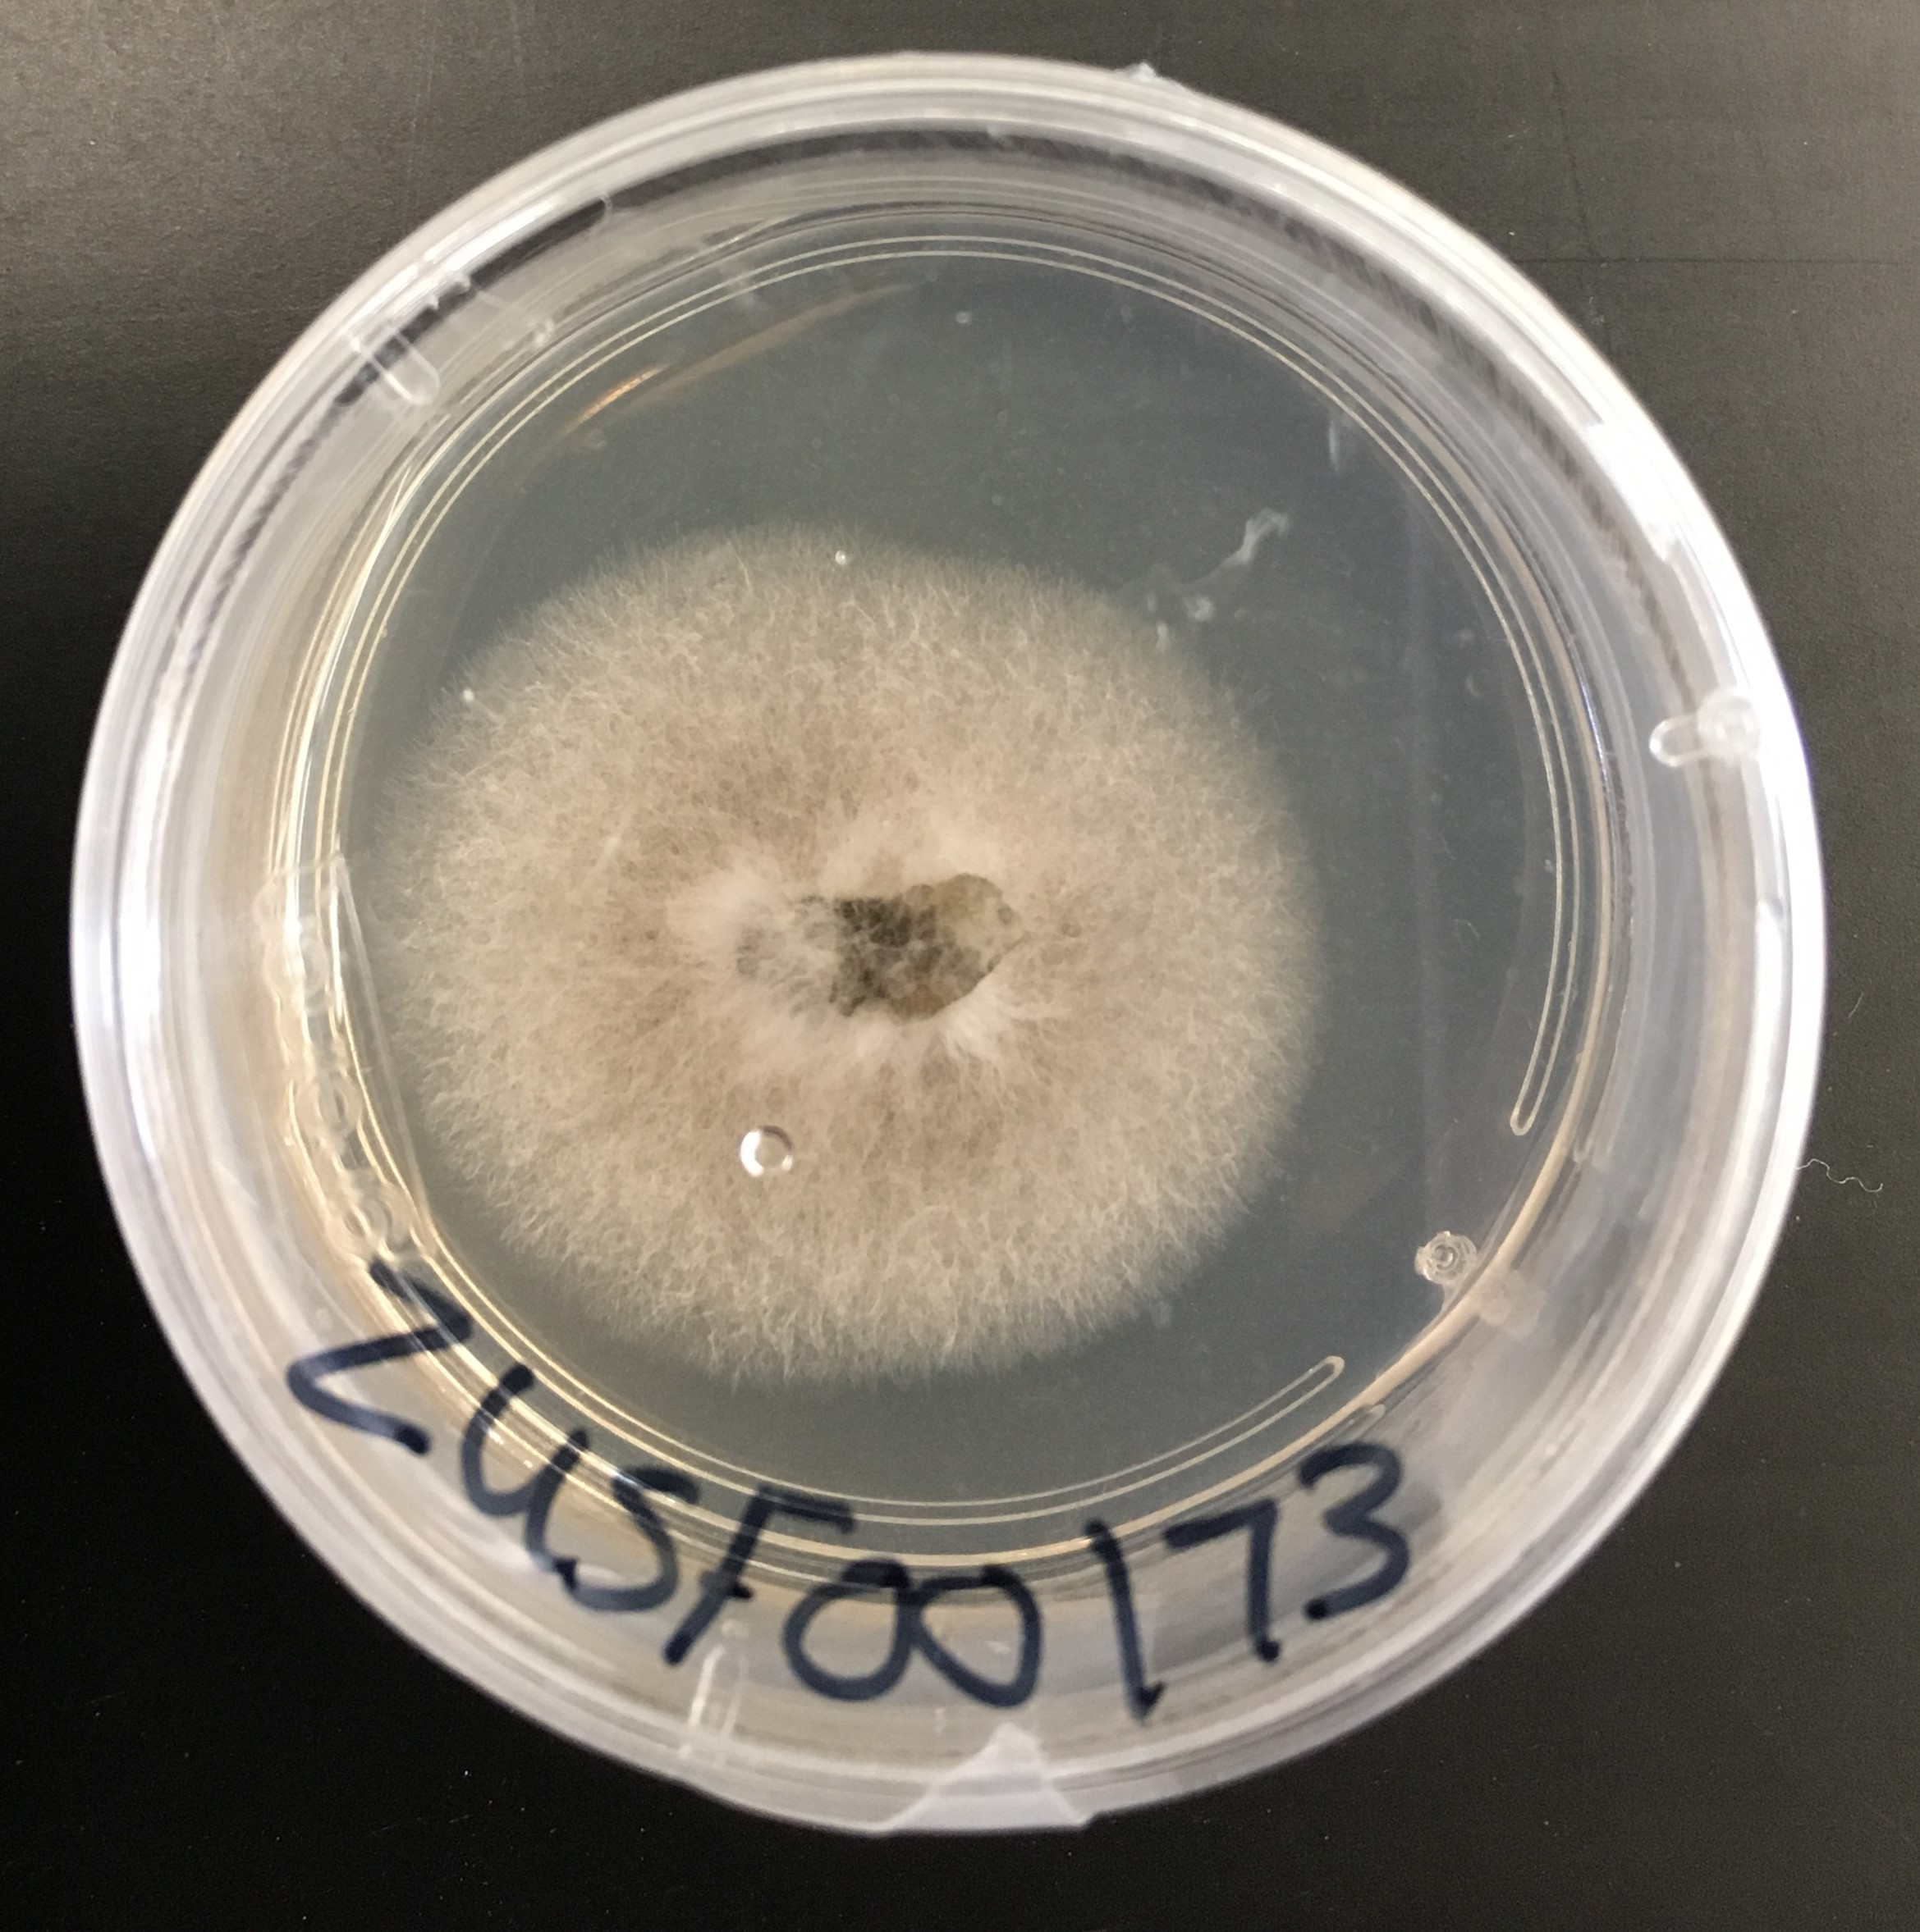
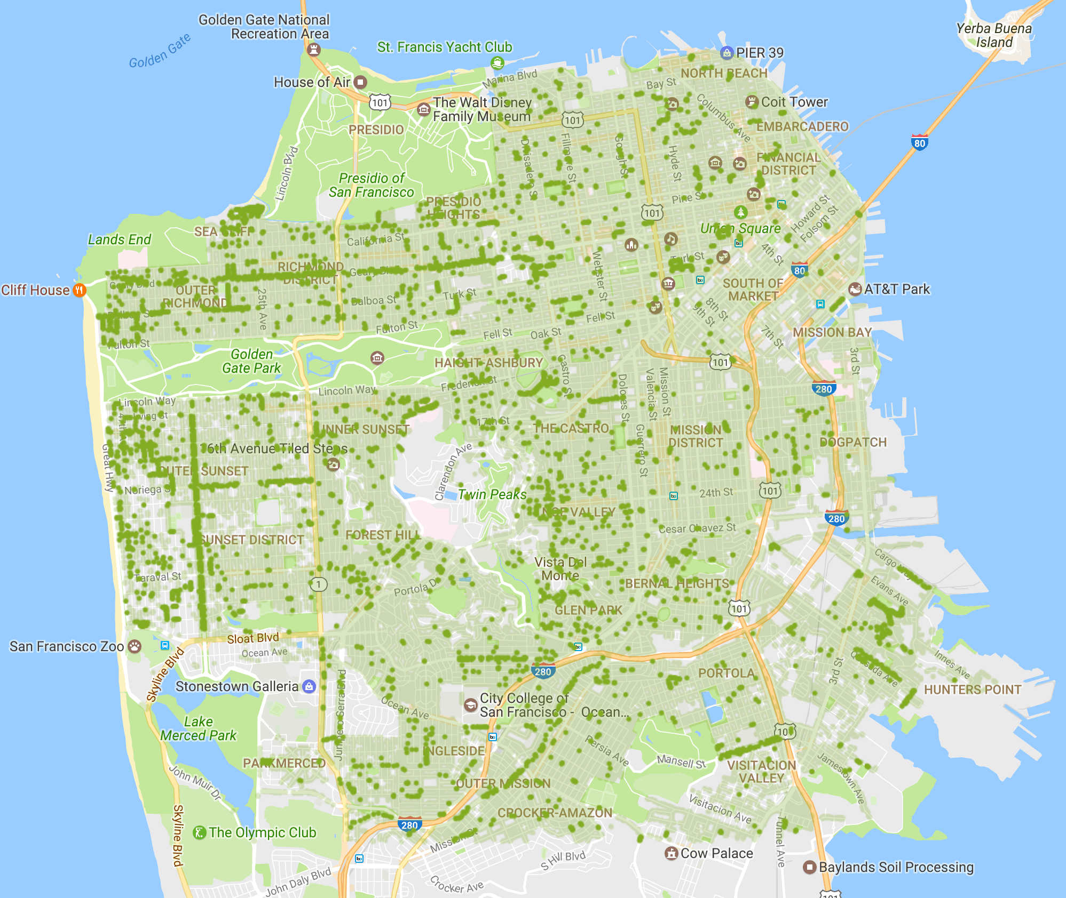
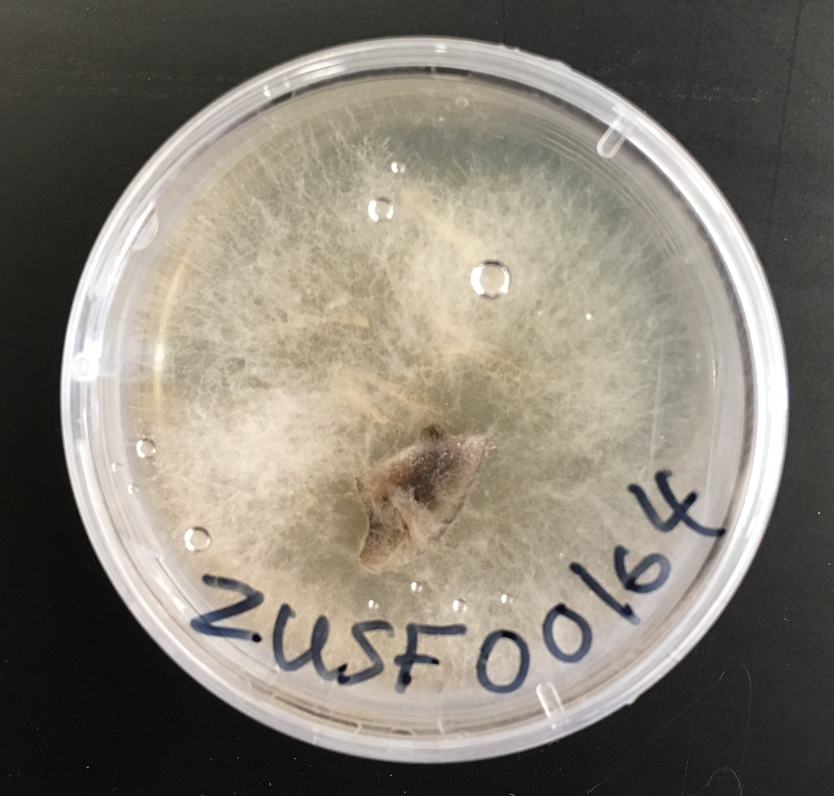
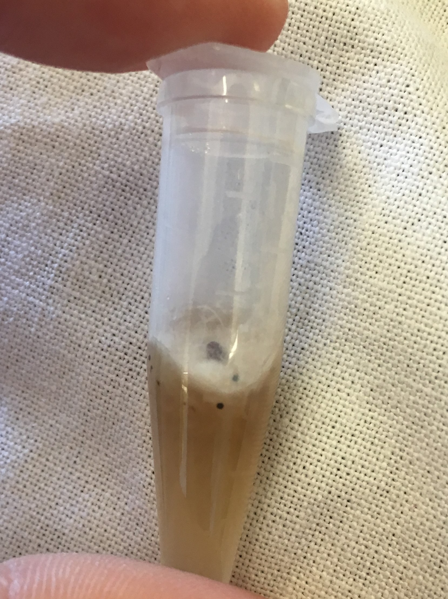
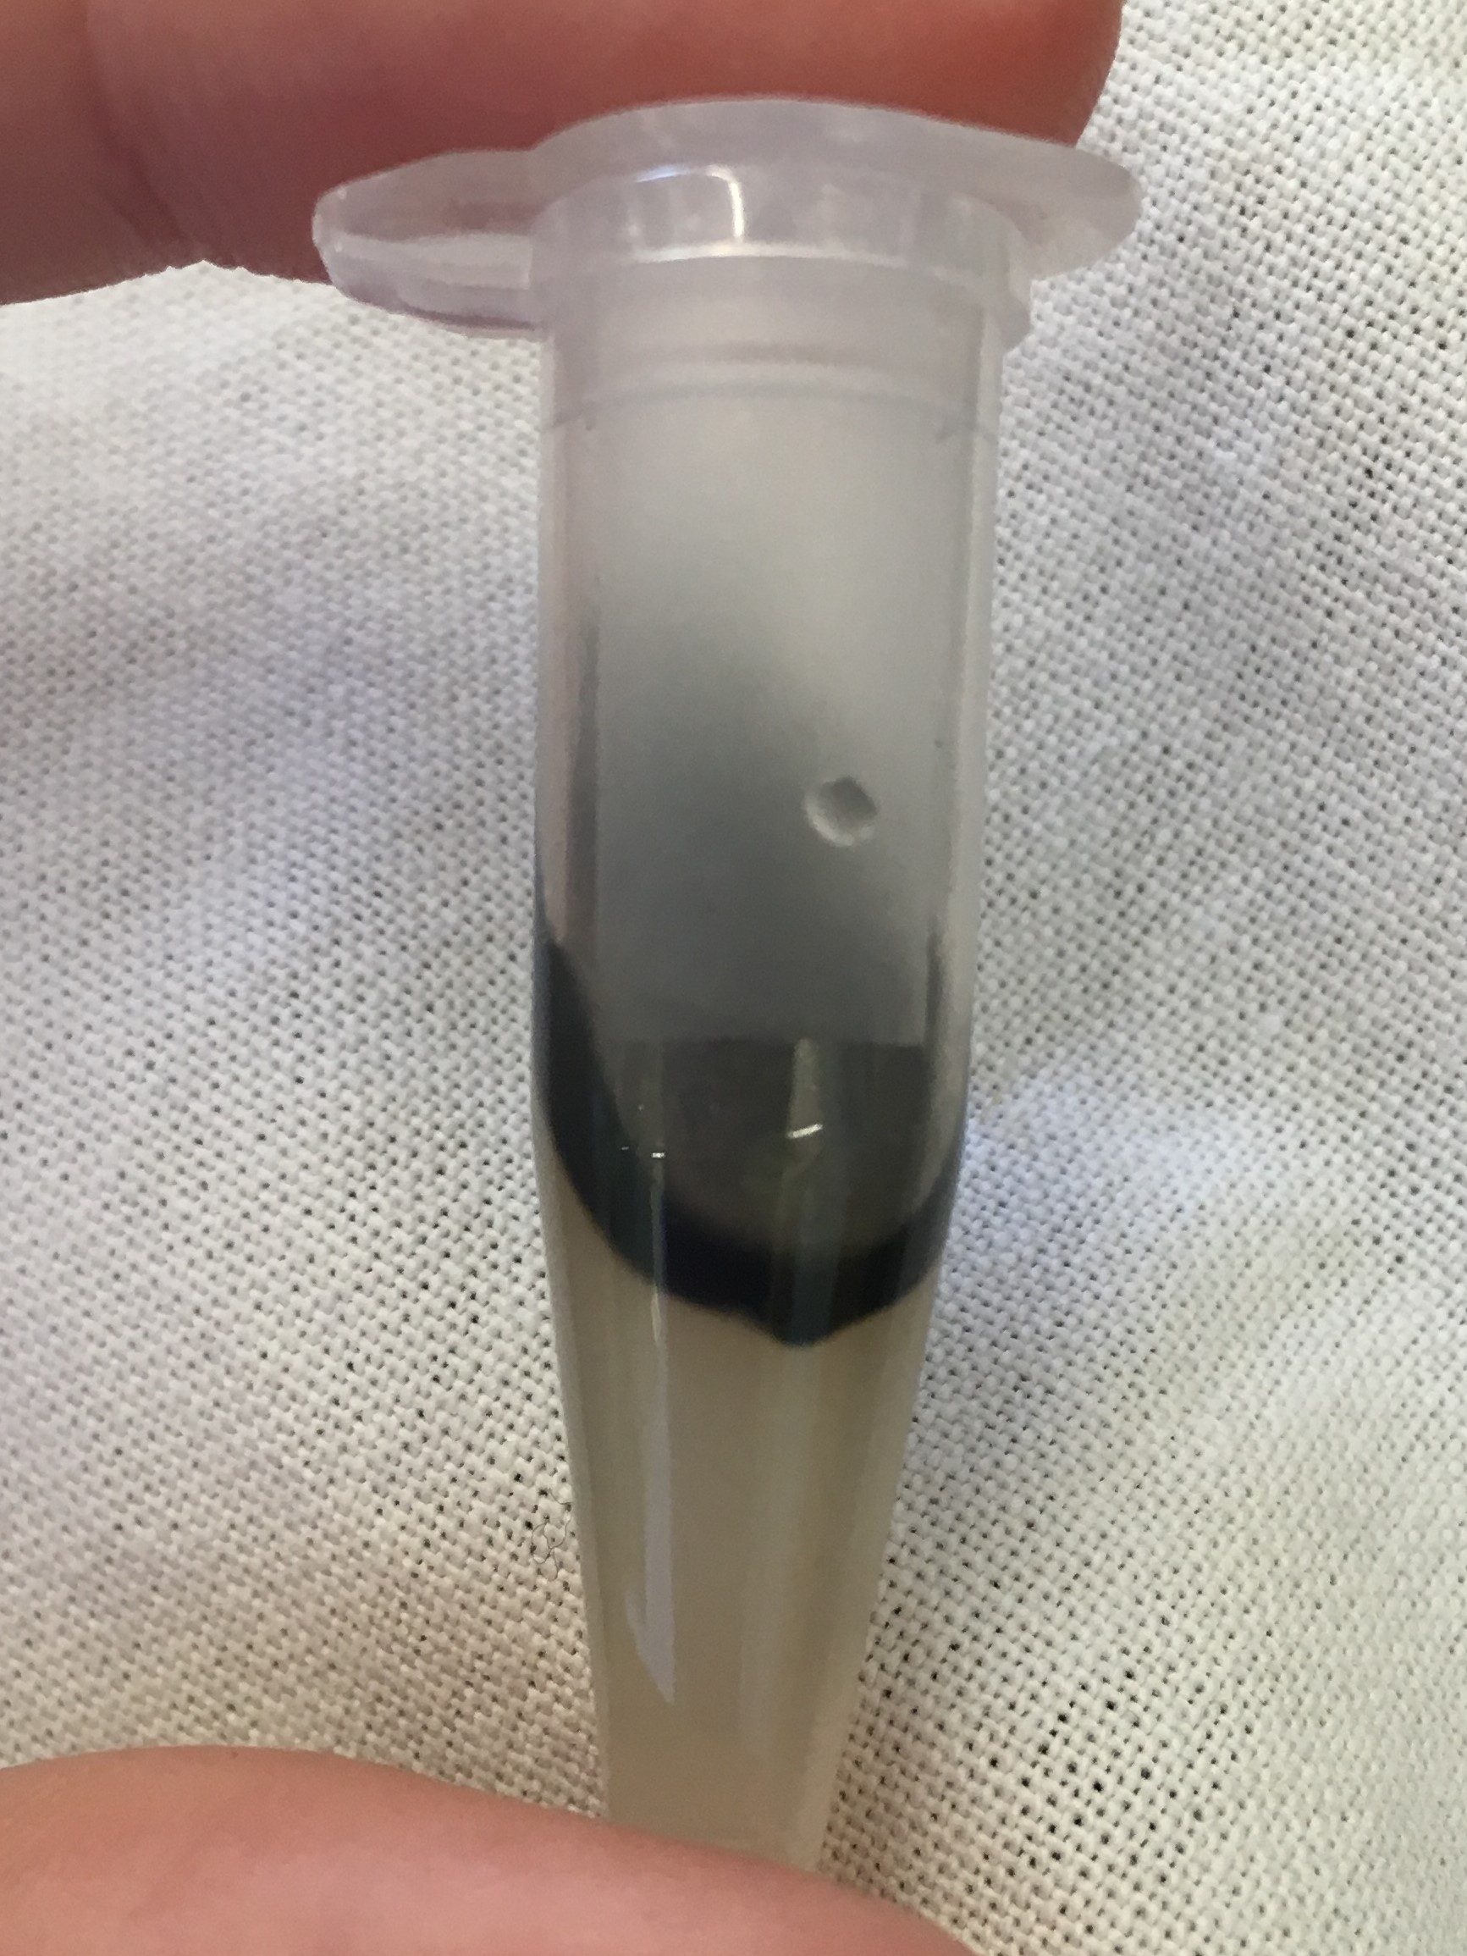
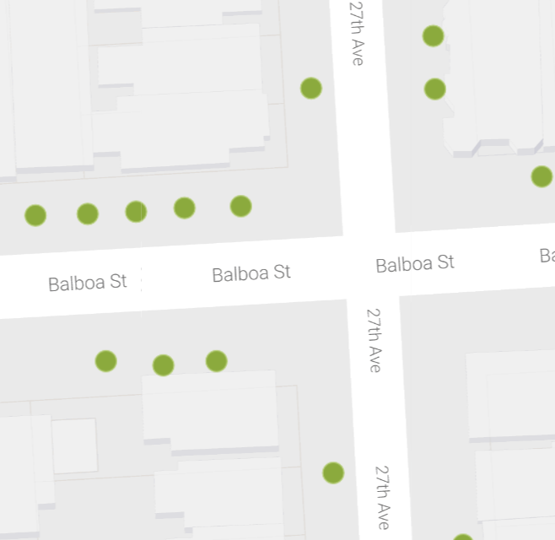
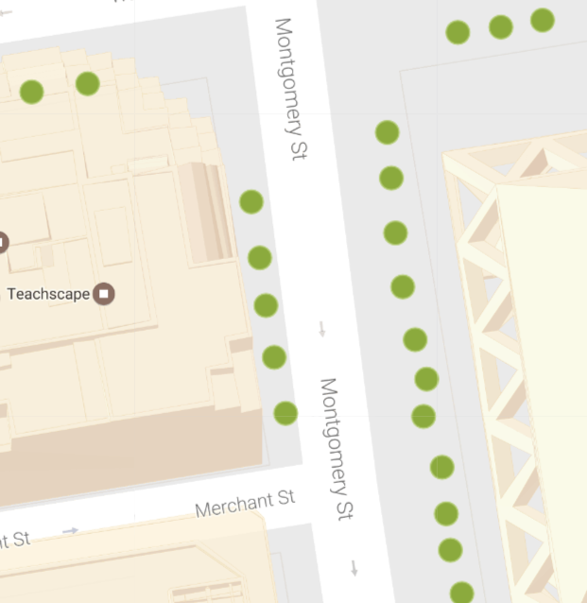
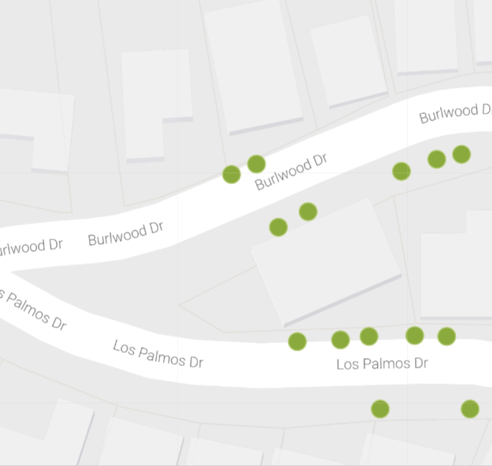
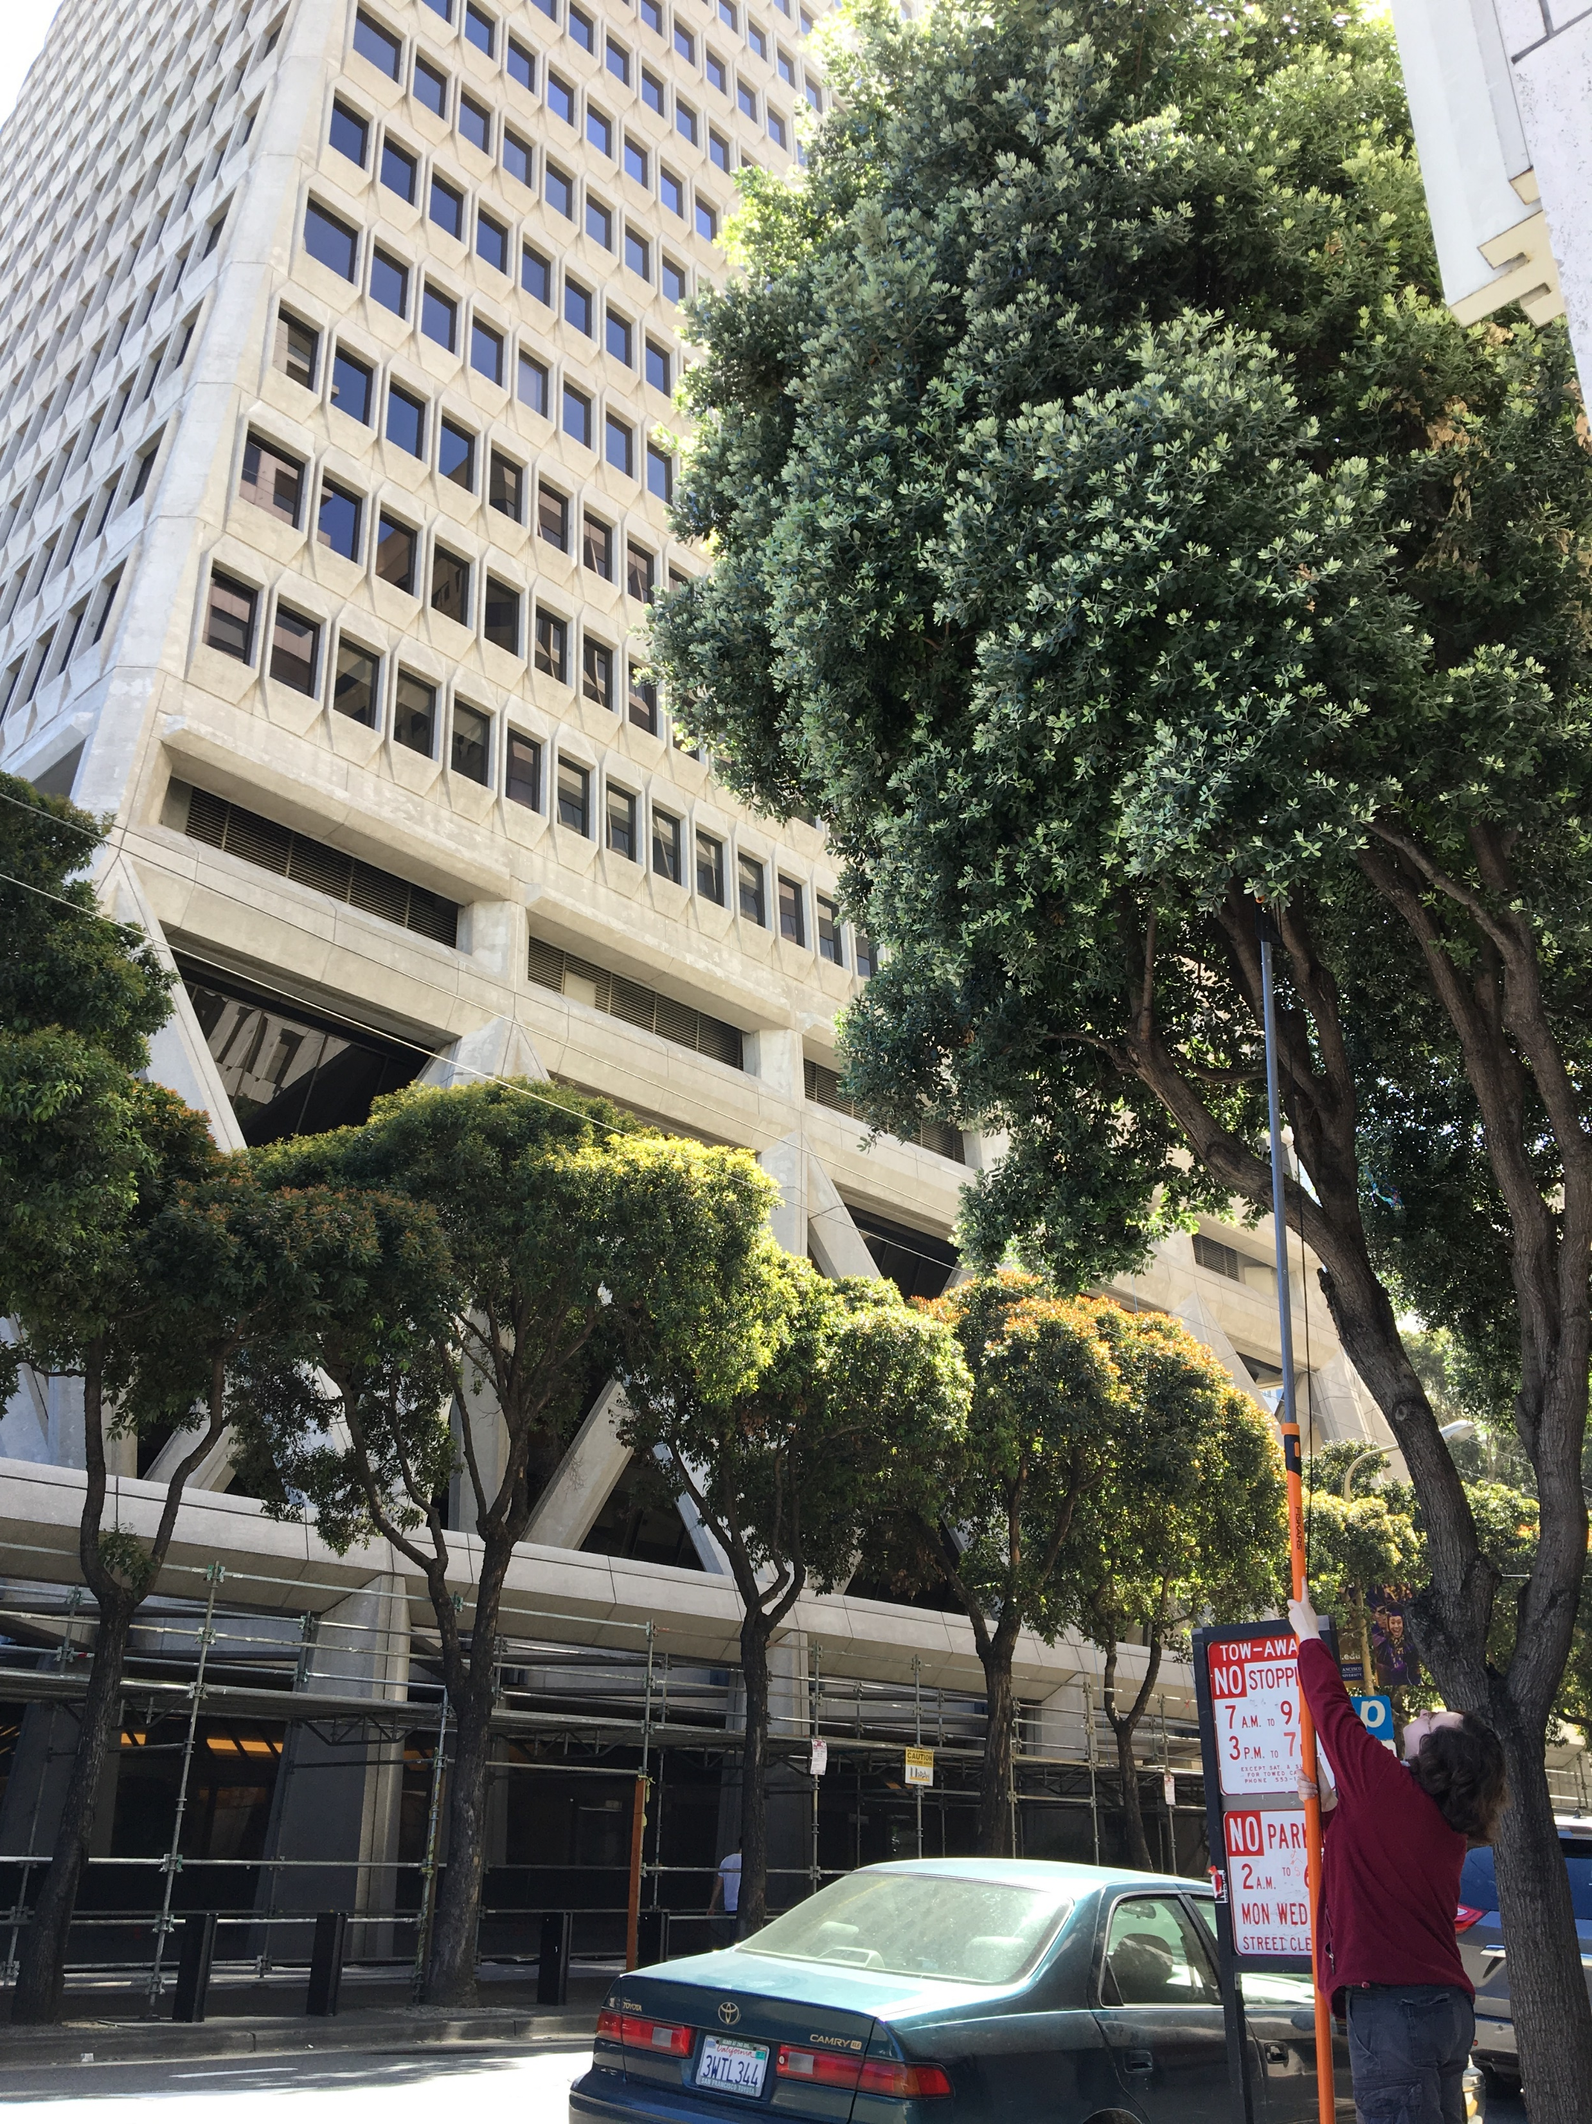
Urban Biogeography of Fungal Endophytes in Metrosideros excelsa in San Francisco
Emma Gibson¹ & Naupaka Zimmerman¹
¹Department of Biology, University of San Francisco
What are endophytes?
Endophytes are microbial organisms, generally bacteria and fungi, that live symbiotically inside the leaves of plants (1). Inoculation experiments have shown that specific species of endophytes can have an impact on their host’s overall health, including factors such as susceptibility to disease (1). In the wild, endophytic communities display remarkable species diversity, even among individual trees from the same species (3). In this study, we sought to document biogeographic patterns of fungal endophytes in an urban setting.
Tree Species Selection Metrosideros excelsa was chosen because it is widely planted in San Francisco, and its endophytic communities in its native home of New Zealand have been well-studied (2). It is also closely related to Metrosideros polymorpha, a Hawaiian species whose endophytes have also been studied (3).
Site Selection
The Urban Forest Map was created by a nonprofit organization in an attempt to map and identify every tree in the city, which includes over 1,000 individuals of Metrosideros excelsa. We used this data, combined with temperature and traffic data from across the city, to select sites representing a variety of environmental conditions.
O
Site 2
Culturing Methods
We collected several branches from each tree and brought them back to the lab. We then surface-sterilized a subset of leaves with bleach and ethanol to kill off any surface microbes. Then we cut the leaves into small pieces and put them into slant tubes filled with malt extract agar. For each tree, we prepared 6 leaves and made 100 tubes. After two weeks, we evaluated them for fungal growth. For tubes that grew, we subcultured the fungi onto larger plates in order to better evaluate their morphotypes and accumulate sufficient tissue for future barcode gene sequencing and voucher preparation.
O
Site 1
O
Site 3
Maps courtesy of the Urban Forest Map website (https://www.opentreemap.org/urbanforestmap/map/).
Results
The isolation frequency of foliar fungi differed significantly between the sites (Kruskal-Wallis p < 0.05), with Site 2 showing the lowest median isolation frequency. We also qualitatively observed different fungal morphotypes between sites.
What’s next?
We will sample more trees downtown to confirm that this initial observation is robust. Further, we plan to sequence the Internal Transcribed Spacer (ITS) locus of these fungi, in order to better understand the correlation between endophytic species and urban environmental factors.
Site 1
Site 2
Site 3
4 3
2 1
4
3
2
1
4
3
1
2
References
1. Busby, P.E., Ridout, M. & Newcombe, G. Plant Mol Biol. 2016. Fungal endophytes: modifiers of plant disease. 90: 645. 10.1007/s11103-015-0412-0
2. McKenzie, E. H. C., P. K. Buchanan, and P. R. Johnston. 1999. Fungi on pohutukawa and other Metrosideros species in New Zealand. New Zealand Journal of Botany 37:335-354.
3. Zimmerman, N.B., and Vitousek, P.M. 2012. Fungal endophyte communities reflect environmental structuring across a Hawaiian landscape. PNAS, 109: 32 p 13022-13027.
Balboa & 27th Avenue
High-traffic, moderate temperature, mid-elevation.
Montgomery & Merchant
Urban, higher temperature, low elevation.
Burlwood & Los Palmos
Low-traffic, lower temperature, higher elevation.

